Slide 1

NFL Data Analytics
Darron Kotoyan, Nic Vamis, & Obada Yosef

Slide 2

Motivation
NV
Our Motivation to pick this specific dataset is that it we are entering into a data analytics competition with this dataset for a cash prize.
We are also interested in working in the sports analytics industry and this project will be a great opportunity to gain some experience in this field.
Overall goal: how does the kick distance and hang time of a kick effect the outcome of a kick return. This can be used by NFL teams to evaluate how their special teams units are performing and how they will perform in the future.
Notes:
We also chose to do this for our final project so that we could get a head start on the project and receive feedback on it so that we can improve it for the competition
Also it looks good on our resume too

Slide 3
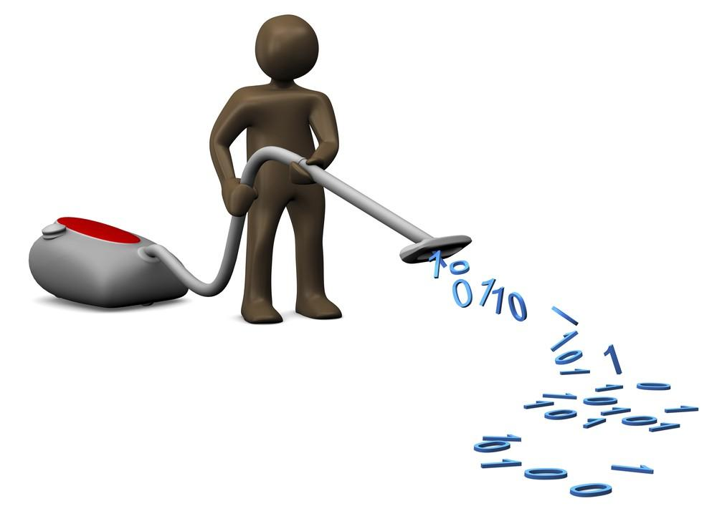
Data Cleaning
OY
Step one: Choosing the datasets to merge.
Step two: Deciding wanted variables and removing unwanted variables in preparation for merge
Step three: Merge datasets respective of “gameId”
Step four: Delete all rows with N/A in important variable information.
Step five: Remove all duplicate rows from the dataset.
Notes:
So for this data cleaning step we first decided that we needed to choose from all the datasets we had available which ones were the most effective at answering the questions we had posed. Second we decided which variables were important for our model and removed the non important ones. Third we began to merge the datasets in respect to the Game ID which is a specific identifier. The fourth step is that we deleted all the rows with N/A in the spot of an important variable. Finally we removed all the duplicate rows from the dataset and then the dataset was ready for analysis.

Slide 4

Variables
Game ID: Specific Identification for each game
Play ID: Specific Identification for each play
Play Description: Type of play, yardage, and how it was received
Quarter: What quarter the game is currently in
Special Teams Play Type: Kickoff or Punt
Kick Length: distance of the kick in yards
Kick Return Yardage: distance of the kick return in yards
Play Result: Net yards gained by kicking team
Hangtime: The amount of time in seconds the ball spends in the air
Kick Contact Type: Details on how the punt was fielded
Return Type: Classified kick return yardage into short, medium, or long distance (Short<20 , 20<Medium<50, 50<Long)
DK
Notes:
11 Variables

Slide 5
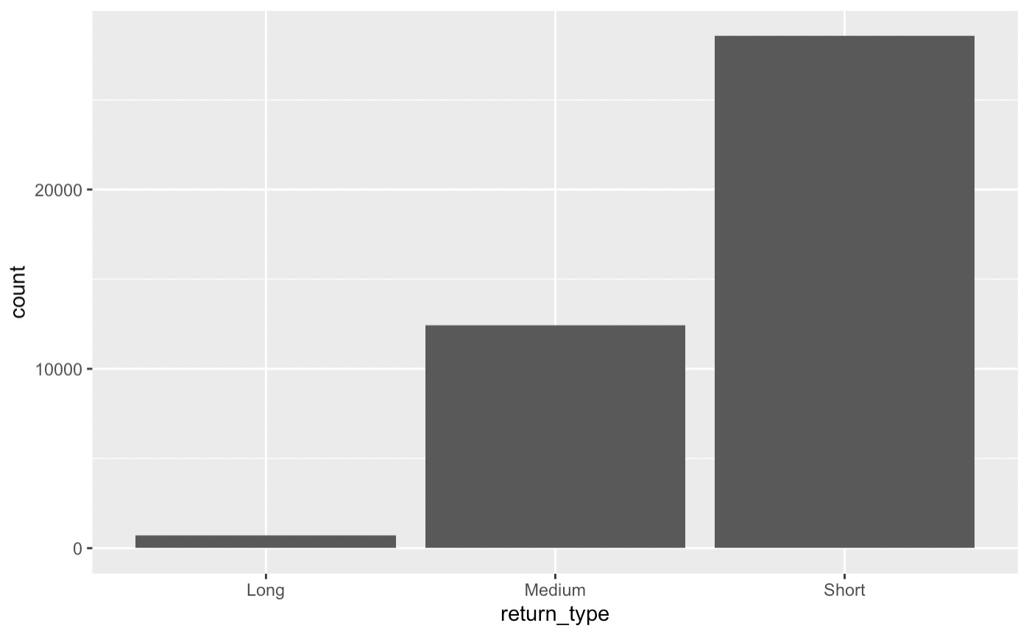
Summary Statistics
OY
kickLength
Min: 2
Max: 90
Mean: 54.58
kickReturnYardage
Min: -16
Max: 104
Mean: 15.08
hangTime
Min: 1.22
Max: 5.69
Mean: 4.317
Notes:
Here we included the summary statistics for the important continuous variables in our model. We found that kick length, Kick return Yardage, and hang time are our important continuous variables. For kick length, our summary statistics produced a minimum of 2, a mean of 54.58, and a max of 90. For kick return yardage, our minimum is -16, our mean is 15.08 and our max is 104. Finally Hang time has a minimum of 1.22, a mean of 4.317, and a maximum of 5.69. We also included a bar chart that shows the count of each return type in our dataset.

Slide 6
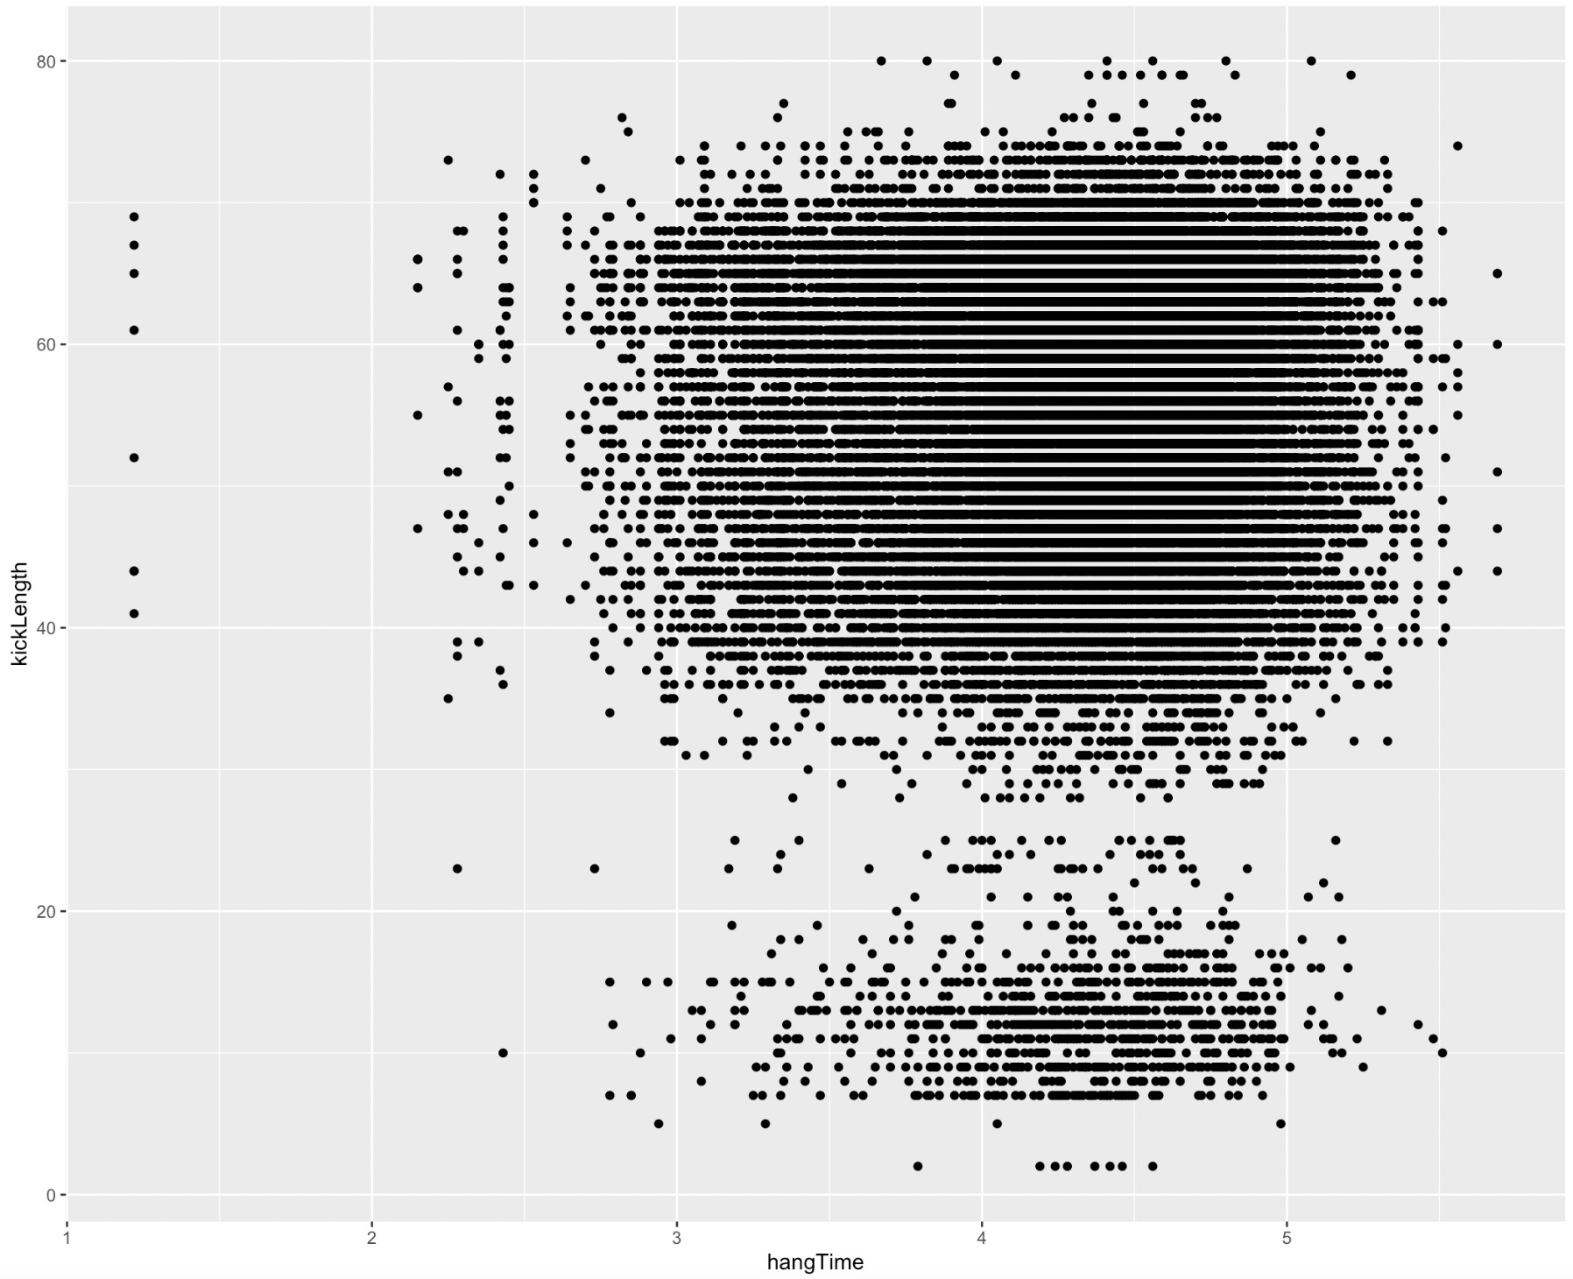
kickLength
Min: 2
Max: 90
Mean: 54.58
kickReturnYardage
Min: -16
Max: 104
Mean: 15.08
hangTime
Min: 1.22
Max: 5.69
Mean: 4.317

Slide 7
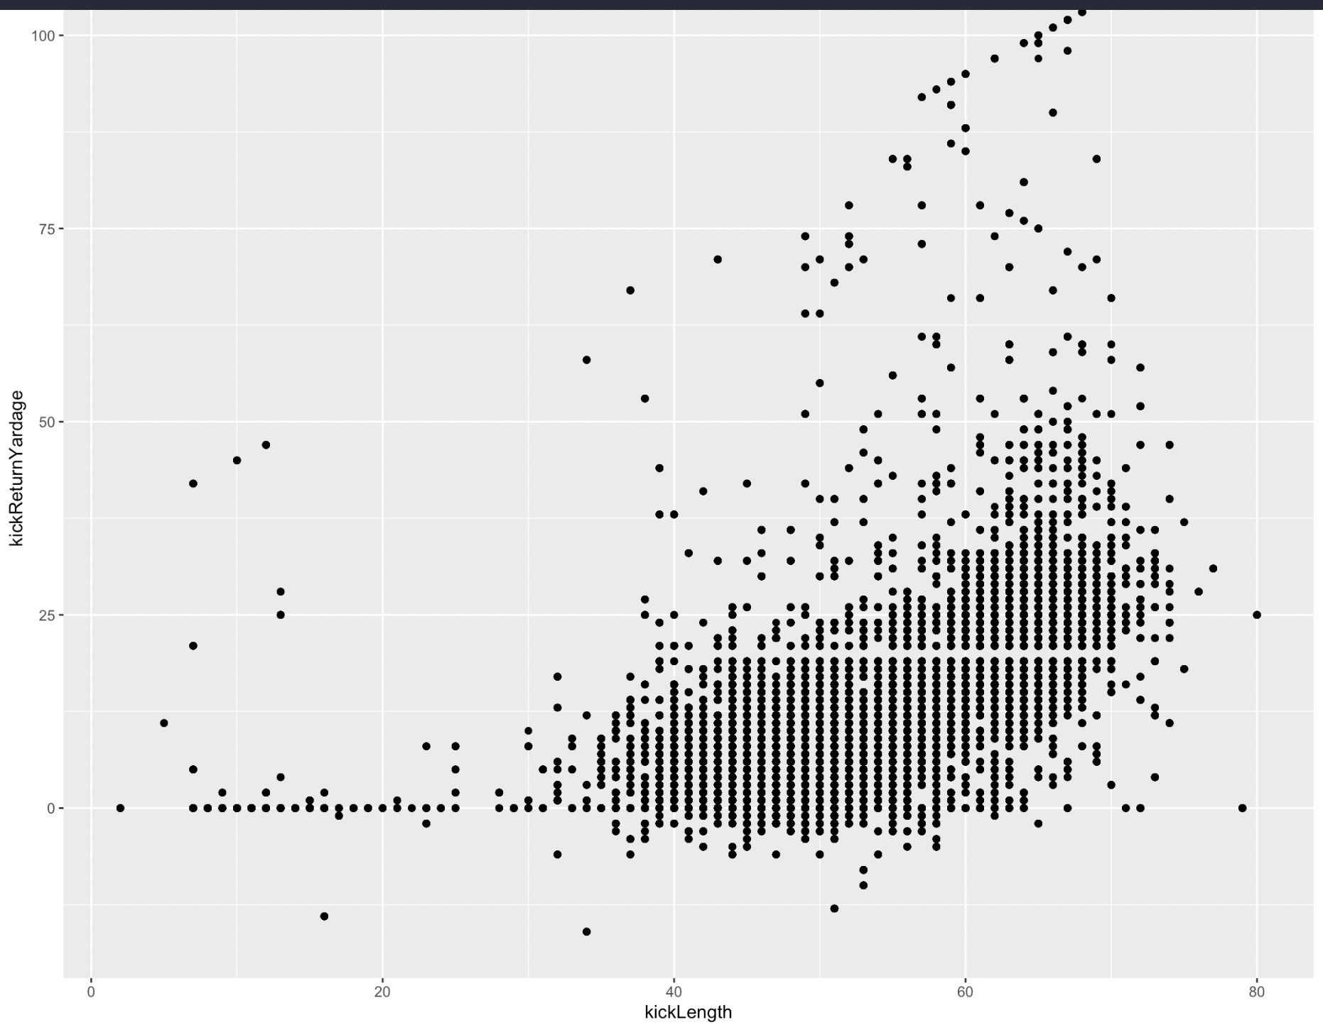
kickLength
Min: 2
Max: 90
Mean: 54.58
kickReturnYardage
Min: -16
Max: 104
Mean: 15.08
hangTime
Min: 1.22
Max: 5.69
Mean: 4.317
Notes:
Hang time compared to kick length: there are 2 clear clusters, short kicks (0-20 yds) and then the long kicks (35-75 yds). Most hang times are between 2.5-6 seconds. Longer kick = longer hang time. The small amount of kicks with low hang times (~1) and high kick distances are most likely squibs, they aren’t in the air for very long but they can roll a lot.
Kick length compared kick return yardage: as kick length increases, so does kick return yardage. Most likely b/c

Slide 8
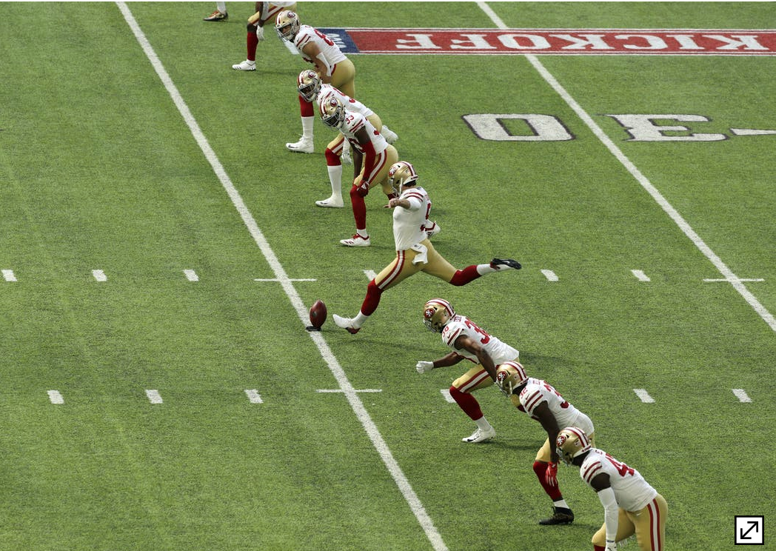
Yard Returned by Hangtime
OY
Linear Regression to predict kick return yardage
X Variables: Hangtime, Kick distance, Kick length, Play result, Kick contact type
Y Variables: Kick return yardage
Conclusion: All though the plot between X and Y has a nice linear pattern and has a high R-squared, we estimated that the model is underfit.
MSE of Training: 0.28 MSE of Testing: 0.92
For Predicted kick returns in yards, 68.7% < 20 yds, 29.9% between 20-50 yds, 1.4% > 50 yds
Notes:
For our first predicted model we decided to go with a simple linear regression. We chose the variables hangtime, kick distance, kick length, play result, and kick contact type in order to predict what the kick return yardage should look like. Our results produced an MSE of 0.28 for training and an MSE of 0.92 for testing. Based off this information for the MSE we estimated that the model is underfit. Approximately 68.7% of the predicted kick returns in yards are less than 20 yards, 29.9% of them are between 20 to 50 yards and 1.4% of all predicted kick returns are more than 50 yards.

Slide 9
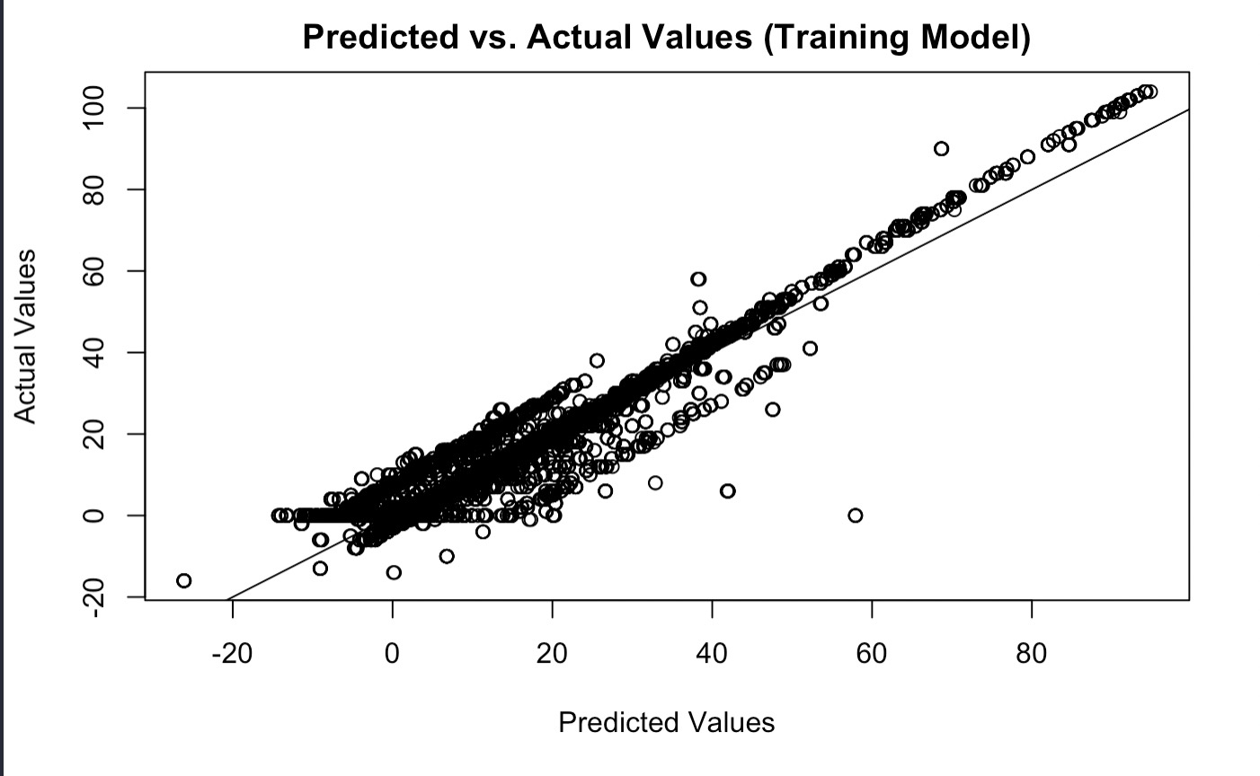
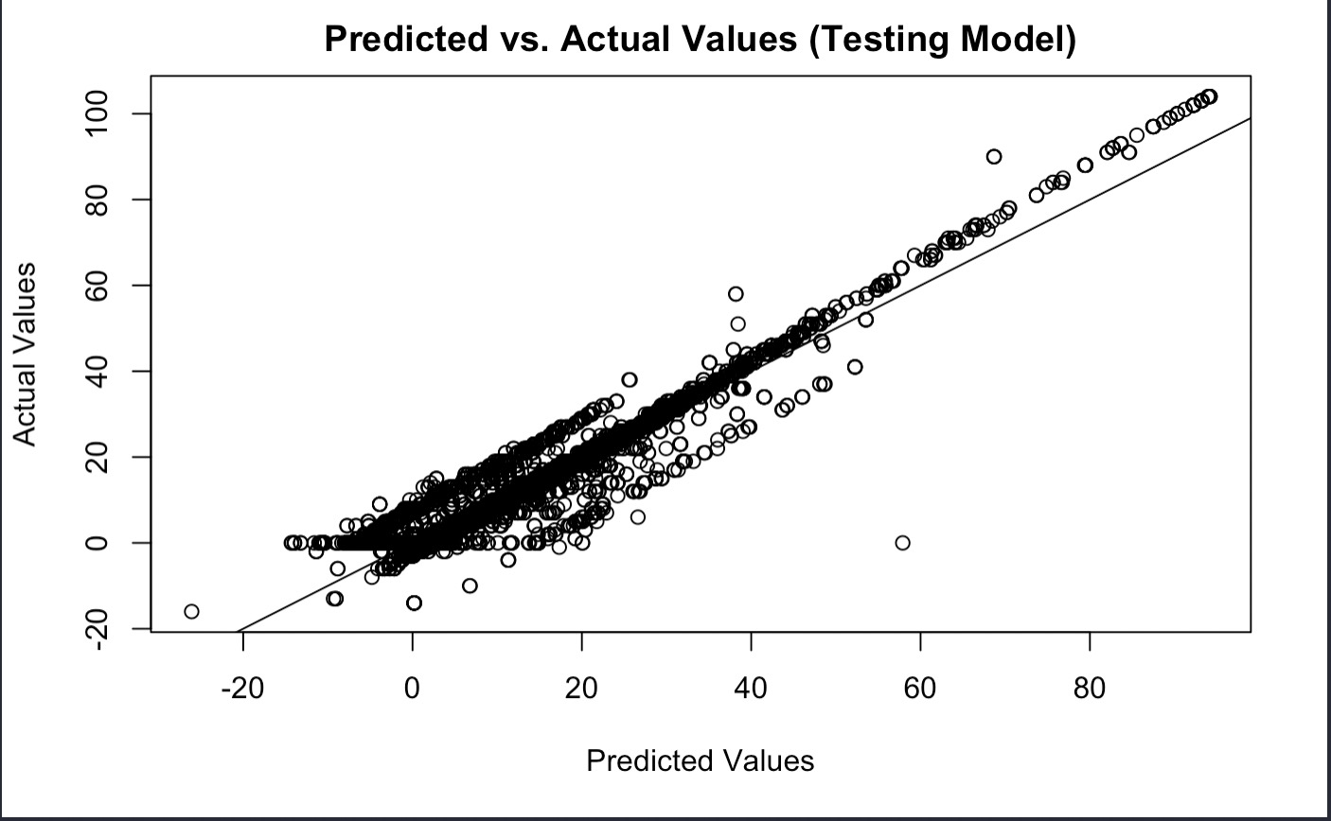
OY
Notes:
Here are two graphs we made, one is showing the predicted vs actual values in the training model and the other is showing the predicted vs actual values in the testing model. We can see on both graphs that they are pretty similar and both share a strong positive linear relationship as show by how they start at the bottom left and move in a line up to the top right. Considering that the MSE of the testing model is higher than the MSE of the training model we conclude that the model is underfit.

Slide 10
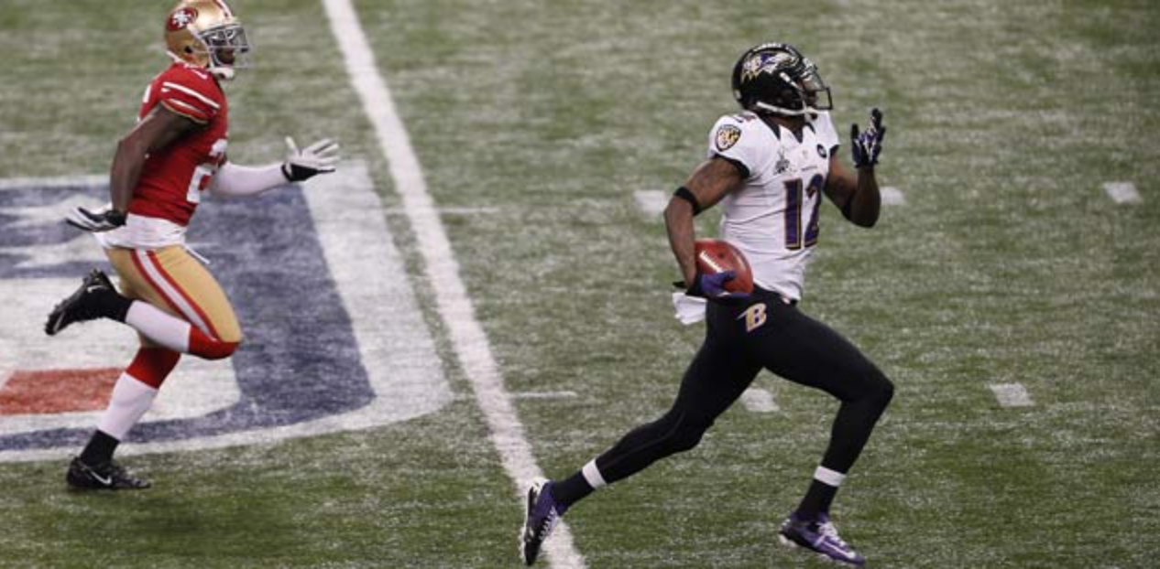
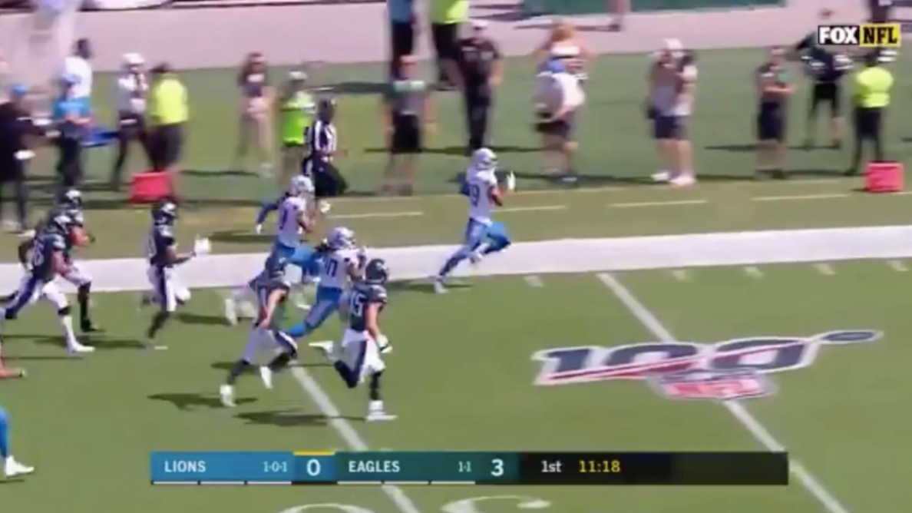
Predicting Short, Medium, or Long Return Distance
Decision tree to determine whether a kick return will be classified as short, medium or long.
X Variables: Hangtime and kick length,
Y Variables: Return Type
Conclusion: The most significant split is with the kick distance. If the hangtime was between 4.27 and 4.59, it had more of an impact on the kick return yardage.
NV

Slide 11
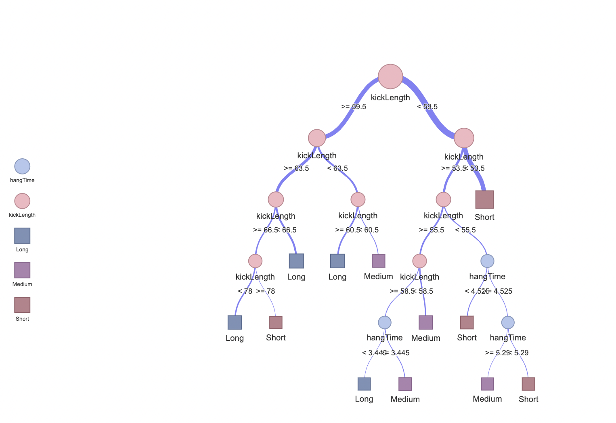
Notes:
This represents our decisions tree find the odds of a kick return being short (<30 yds), medium (30-50 yds), or long(>50yds) based on our predictor variables (kick length and hang time). The blue line represents the connection between our tree nodes and the short/medium/long return outcome. The thickest blue line at the top represents the most probable outcome, which is that a kick <53.5 yards will have a short return. The line is the thickest because this is the “path most traveled”. The outcome w the highest odds of occurring and occurs the most in the data.

Slide 12
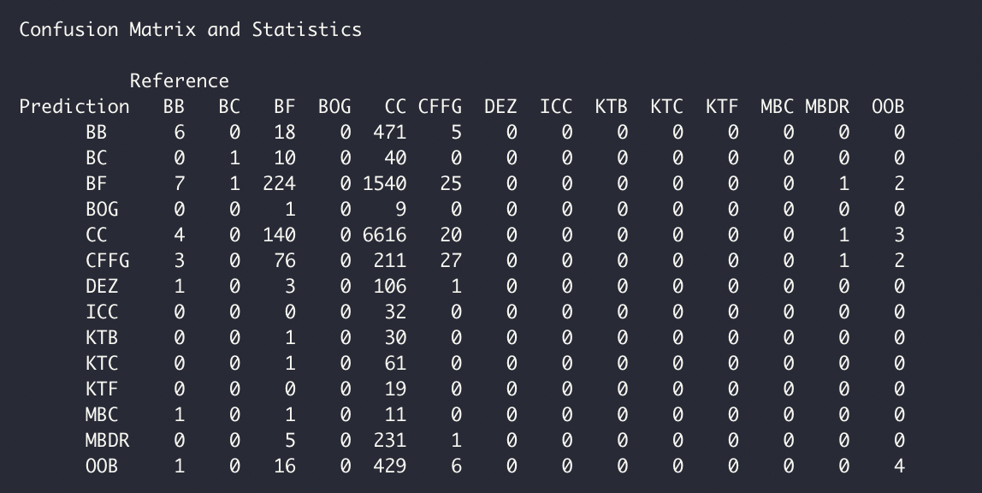
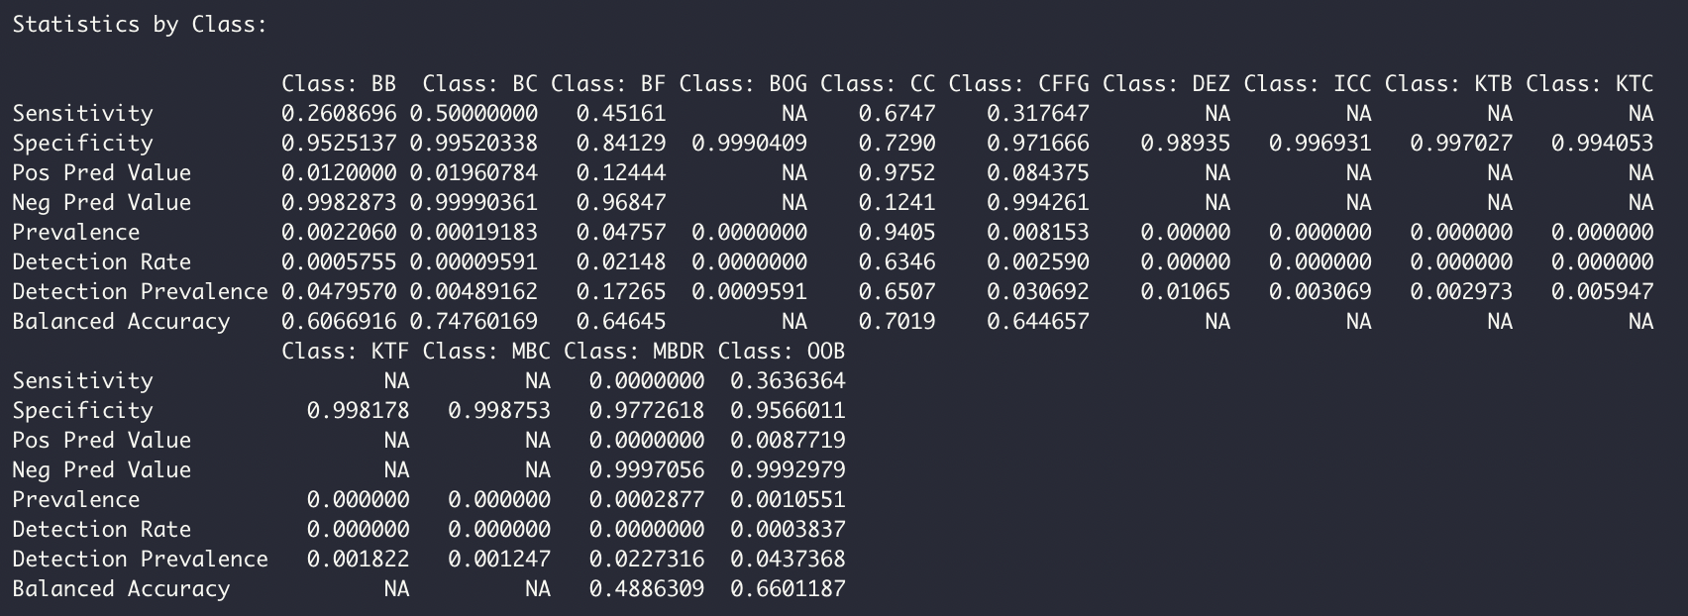
Predicting Kick Contact Type
Random Forest model to predict the kick contact type
X Variables: Hangtime and kick length
Y Variables: Kick contact type
Conclusion: Kick length seems to be the more significant of the two X variables. For each of the 13 possible categorical outcomes, we can conclude that Class CC (Clean Catch from air) has the highest prevalence out of all the other outcomes. In the confusion matrix CC has the highest number of true positives. Our model has 66% accuracy.
Notes:
So here we used a random forest model to try and predict the kick contact type. If you go to the next slide you can see what kick contact type means, which is basically details how the kick was fielded. To see the results we used a confusion matrix and from the matrix we got

Slide 13
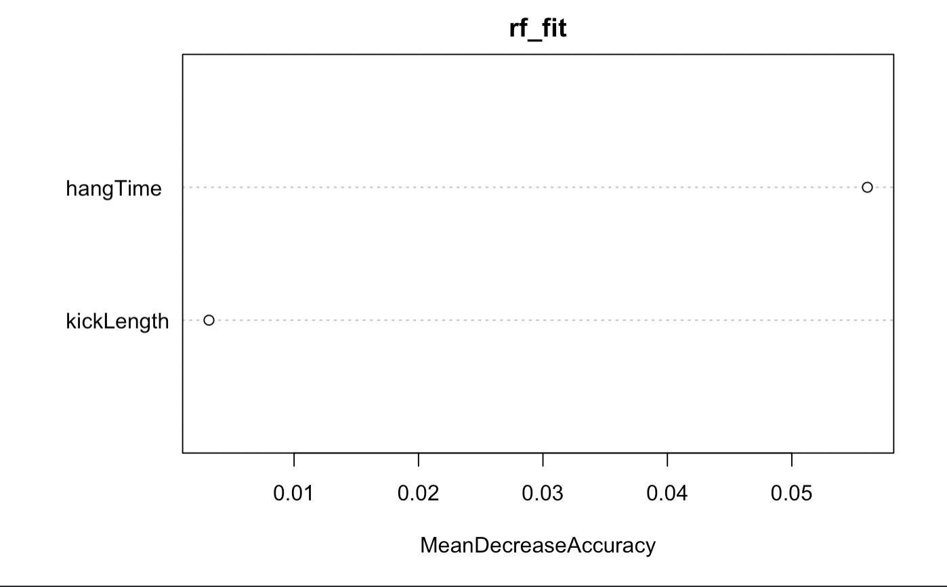
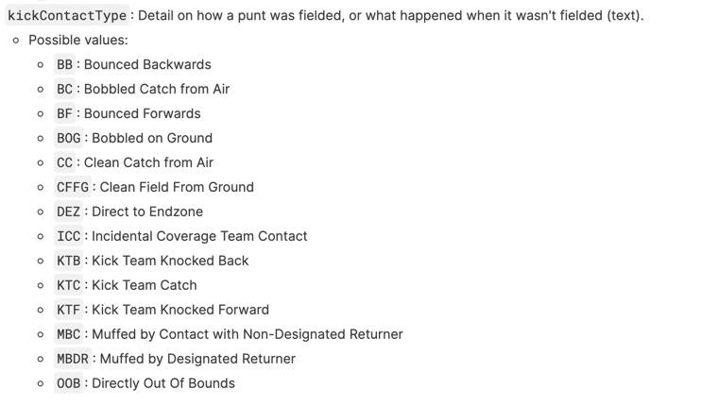

Slide 14
Final Thoughts/Solution
Based off our analysis of the dataset we can conclude that the largest overall factor in kick return yardage is kick length. This hypothesis was of course expected as it makes the most logical sense.
Our goal was to discover the the relationship between hang time of kick and kick distance affect the outcome and return of the kick. Based on the decision tree, kicks that are less than 53 yards have a very high chance of having a short return, longer kicks vary in outcome.
Notes:
Talk about results from the decision tree to determine how different kick lengths and hang times effect the short, medium, and long category of return
Linear model is the best model,

